Slide 1
GEOMETRIC PRIMITIVES

Slide 2
DDA
(DIGITAL DIFFRENTIAL ANALYZER)
1 . Get the input of two end points (X0,Y0) and (X1,Y1).
2. Calculate the difference between two end points of a st. line.
dx = X₁ - X₀
dy = Y₁ - Y₀
3.Identify the number of steps to put pixel
if (dx > dy)
Steps = absolute(dx);
else
Steps = absolute(dy);
4. Calculate the increment in x coordinate and y coordinate.
Xincrement = dx / steps;
Yincrement = dy / steps;
5. Put the pixel by incrementing x and y coordinates accordingly.
x_{K+1} = x_{K} + Xincrement;
y_{K+1}= y_{k} + Yincrement;
x₀ ₌ X_{0,}
y₀ ₌ Y₀ k=0,1,2,…(steps-1)

Slide 3
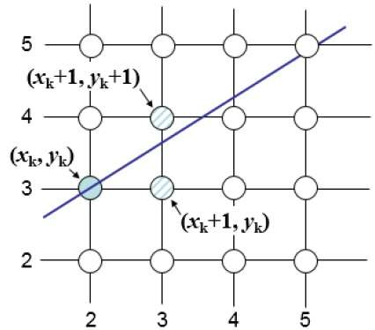
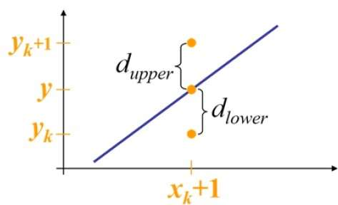
Bresenham’s Algorithm
http://www.tutorialspoint.com/computer_graphics/line_generation_algorithm.htm

Slide 4
y = m(x_{k}+1) + b
d_{lower}=y−y_{k}
=m(x_{k}+1)+b−y_{k}
d_{upper}=(y_{k}+1)−y
=y_{k}+1−m(x_{k}+1)−b
d_{lower}−d_{upper}=2m(x_{k}+1)−2y_{k}+2b−1
k^{th} step decision parameter
p_{k}=dx(d_{lower}−d_{upper})
If p_{k} is +ve then we choose y_{k+1}
-ve then we choose y_{k}

Slide 6
Algorithm
Among two endpoints of a straight line find the left one ,( )
Calculate
At each starting from K=0,
If choose as the next point to plot
Otherwise choose as the next point to plot

Slide 7
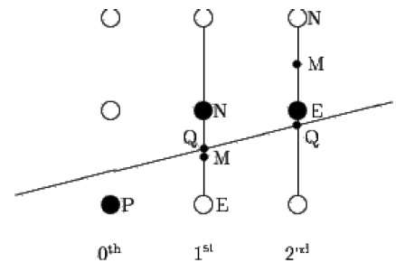
Midpoint line drawing Algorithm
Calculate the middle point
Calculate intersection point Q of the line with the vertical line connecting N and E
If Q is bellow M then select E as next point
Otherwise if Q is above M select N

Slide 8
LINE STYLE
Solid line
Dashed line
Dotted line

Slide 9
Mask:1111000
Span Length:4
Interspan spacing:3

Slide 10
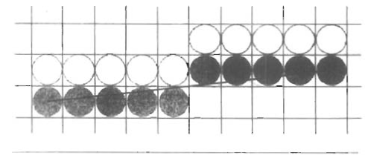
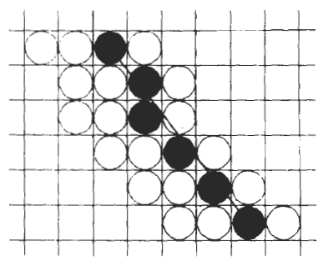
Line width:1
Line width:2
Line width:3

Slide 11
Midpoint circle drawing algorithm

Slide 12
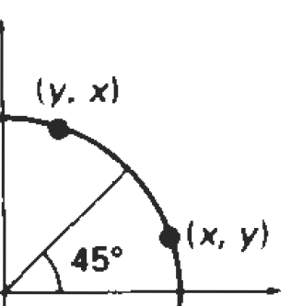
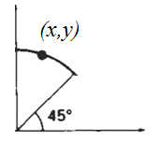
Midpoint circle drawing algorithm
Y
Y
y_{c}
X
x_{c}
X
Y
(-x,y)
(x,y)
(x,y)
X
(y,x)
(-x,-y)
(x,-y)

Slide 13
If (x,y) is on the boundary
If (x,y) is inside the boundary
If (x,y) is outside the boundary
We have plotted (x_{k},y_{k}) and next pixel is (x_{k+1},y_{k+1}) where x_{k+1 =}x_{k}+1
y_{k+1 =}y_{k} or y_{k}+1

Slide 14
(0,r)
(0,0)

Slide 15
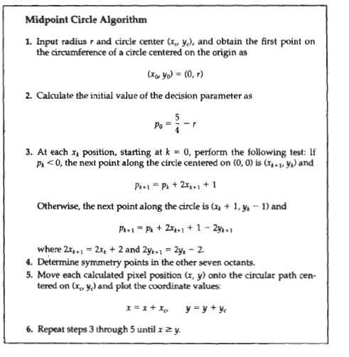

Slide 16
Midpoint ellipse drawing algorithm

Slide 17
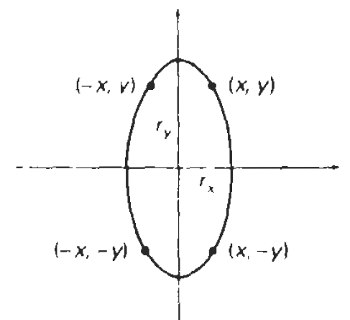
Y
Y
r_{y}
r_{y}
r_{x}
r_{x}
X
X
Y
r_{y}
r_{x}
X

Slide 18
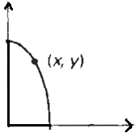
r_{y}
r_{x}
If (x,y) is on the boundary
If (x,y) is inside the boundary
If (x,y) is outside the boundary

Slide 19
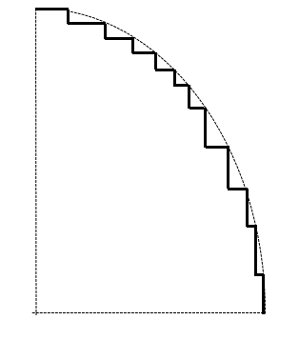
r_{y}
r_{y}
Region I
r_{x}
Region I
Region II
r_{x}
Region II

Slide 20
Region I
Region II

Slide 21
Region I
We have plotted (x_{k},y_{k}) and next pixel is (x_{k+1},y_{k+1}) where x_{k+1 =}x_{k}+1
y_{k+1 =}y_{k} or y_{k}-1

Slide 22
Region II
We have plotted (x_{k},y_{k}) and next pixel is (x_{k+1},y_{k+1}) where x_{k+1 =}x_{k} or x_{k}+1
y_{k+1 =}y_{k} -1

Slide 23
(x₀,y₀) is the last point of region I

Slide 24
